Slide 1
The Network Layer
Chapter 5
Computer Networks, Fifth Edition by Andrew Tanenbaum and David Wetherall, © Pearson Education-Prentice Hall, 2011

Slide 2
Network Layer Design Issues
Store-and-forward packet switching
Services provided to transport layer
Implementation of connectionless service
Implementation of connection-oriented service
Comparison of virtual-circuit and datagram networks
Computer Networks, Fifth Edition by Andrew Tanenbaum and David Wetherall, © Pearson Education-Prentice Hall, 2011

Slide 3
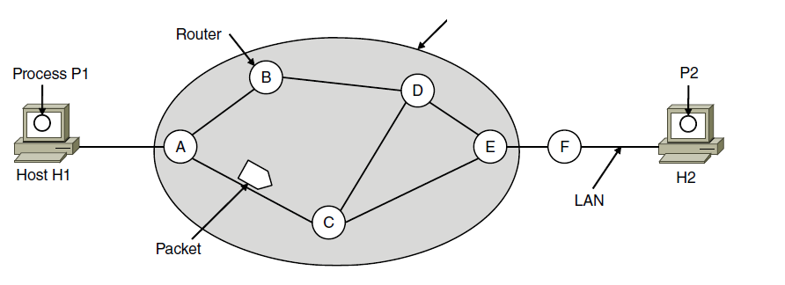
Store-and-Forward Packet Switching
ISP’s equipment
The environment of the network layer protocols.
Computer Networks, Fifth Edition by Andrew Tanenbaum and David Wetherall, © Pearson Education-Prentice Hall, 2011

Slide 4
Services Provided to the Transport Layer
The services need to be carefully designed with the
following goals in mind:
Services independent of router technology.
Transport layer shielded from number, type, topology of routers.
Network addresses made available to transport layer use uniform numbering plan
even across LANs and WANs
Computer Networks, Fifth Edition by Andrew Tanenbaum and David Wetherall, © Pearson Education-Prentice Hall, 2011

Slide 5
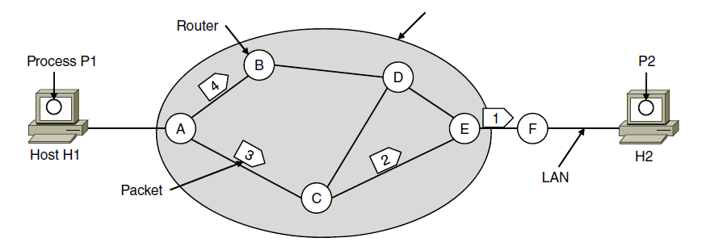
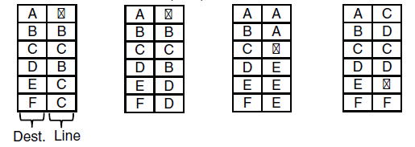
Implementation of Connectionless Service
ISP’s equipment
A’s table (initially) A’s table (later) C’s Table E’s Table
Routing within a datagram network
Computer Networks, Fifth Edition by Andrew Tanenbaum and David Wetherall, © Pearson Education-Prentice Hall, 2011

Slide 6
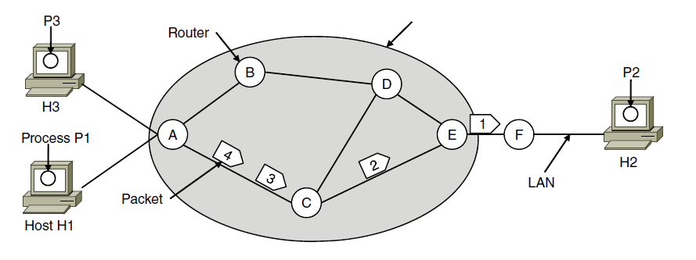

Implementation of Connection-Oriented Service
ISP’s equipment
A’s table C’s Table E’s Table
Routing within a virtual-circuit network
Computer Networks, Fifth Edition by Andrew Tanenbaum and David Wetherall, © Pearson Education-Prentice Hall, 2011

Slide 7
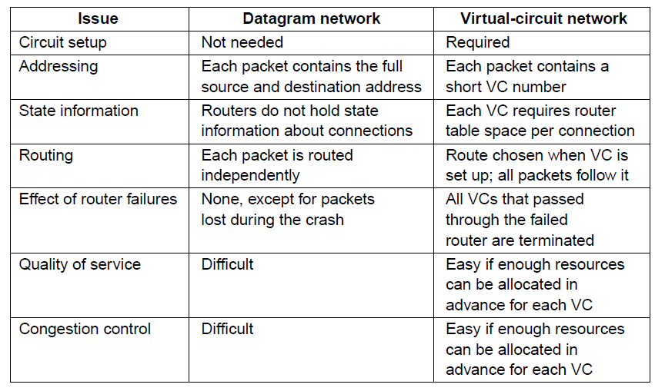
Comparison of Virtual-Circuit and Datagram Networks
Comparison of datagram and virtual-circuit networks
Computer Networks, Fifth Edition by Andrew Tanenbaum and David Wetherall, © Pearson Education-Prentice Hall, 2011

Slide 8
Routing Algorithms (1)
Shortest path algorithm
Flooding
Distance vector routing
Link state routing
Hierarchical Routing
Broadcast routing
Multicast routing
Computer Networks, Fifth Edition by Andrew Tanenbaum and David Wetherall, © Pearson Education-Prentice Hall, 2011

Slide 9
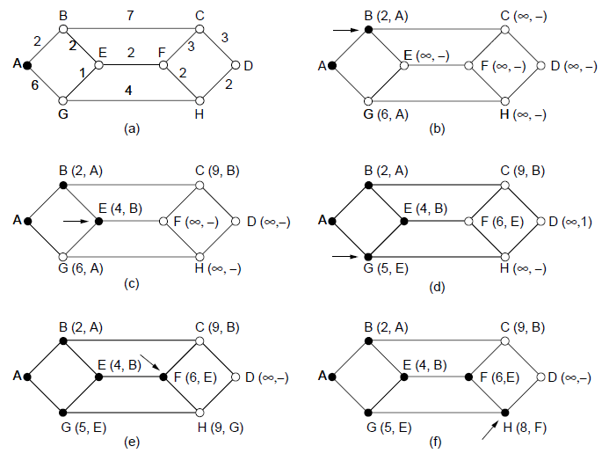
Shortest Path Algorithm (1)
The first five steps used in computing the shortest path from A to D. The arrows indicate the working node
Computer Networks, Fifth Edition by Andrew Tanenbaum and David Wetherall, © Pearson Education-Prentice Hall, 2011

Slide 10
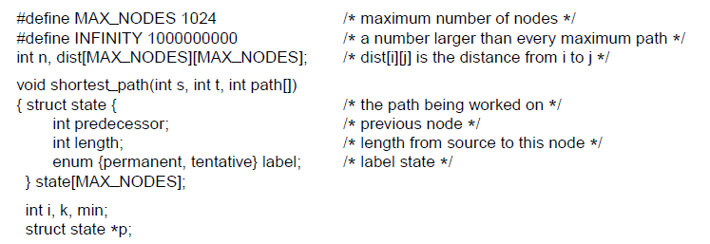
Shortest Path Algorithm (2)
. . .
Dijkstra’s algorithm to compute the shortest path through a graph.
Computer Networks, Fifth Edition by Andrew Tanenbaum and David Wetherall, © Pearson Education-Prentice Hall, 2011

Slide 11
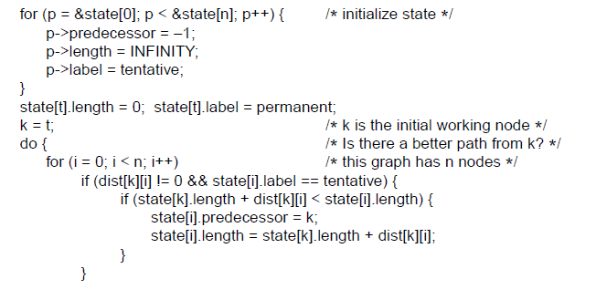
Shortest Path Algorithm (3)
. . .
. . .
Dijkstra’s algorithm to compute the shortest path through a graph.
Computer Networks, Fifth Edition by Andrew Tanenbaum and David Wetherall, © Pearson Education-Prentice Hall, 2011

Slide 12
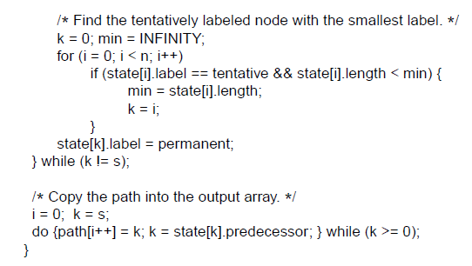
Shortest Path Algorithm (4)
. . .
Dijkstra’s algorithm to compute the shortest path through a graph.
Computer Networks, Fifth Edition by Andrew Tanenbaum and David Wetherall, © Pearson Education-Prentice Hall, 2011

Slide 13
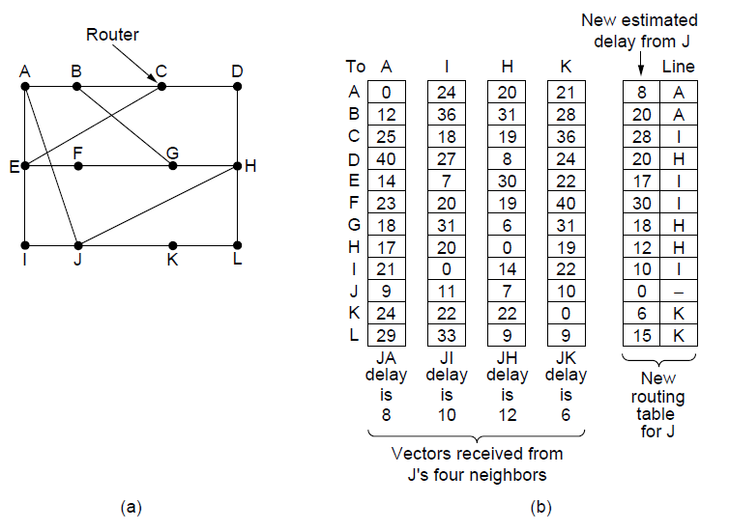
Distance Vector Routing
(a) A network. (b) Input from A, I, H, K, and the new routing table for J.
Computer Networks, Fifth Edition by Andrew Tanenbaum and David Wetherall, © Pearson Education-Prentice Hall, 2011

Slide 14
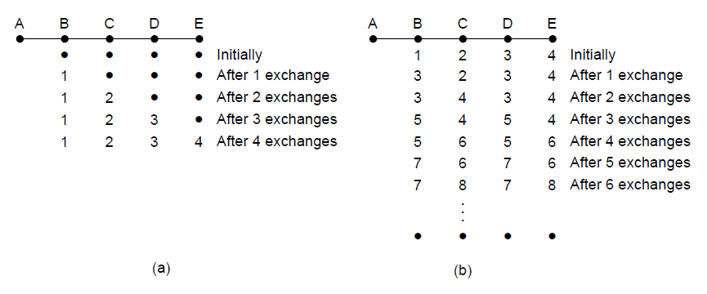
The Count-to-Infinity Problem
The count-to-infinity problem
Computer Networks, Fifth Edition by Andrew Tanenbaum and David Wetherall, © Pearson Education-Prentice Hall, 2011

Slide 15
Link State Routing
Discover neighbors, learn network addresses.
Set distance/cost metric to each neighbor.
Construct packet telling all learned.
Send packet to, receive packets from other routers.
Compute shortest path to every other router.
Computer Networks, Fifth Edition by Andrew Tanenbaum and David Wetherall, © Pearson Education-Prentice Hall, 2011

Slide 16
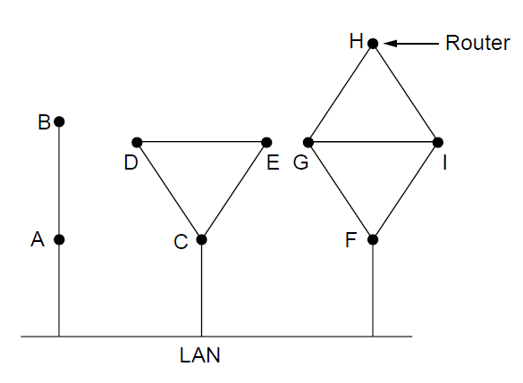
Learning about the Neighbors (1)
Nine routers and a broadcast LAN.
Computer Networks, Fifth Edition by Andrew Tanenbaum and David Wetherall, © Pearson Education-Prentice Hall, 2011

Slide 17
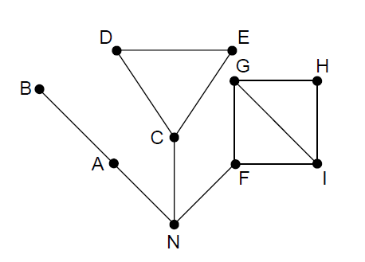
Learning about the Neighbors (2)
A graph model of previous slide.
Computer Networks, Fifth Edition by Andrew Tanenbaum and David Wetherall, © Pearson Education-Prentice Hall, 2011

Slide 18
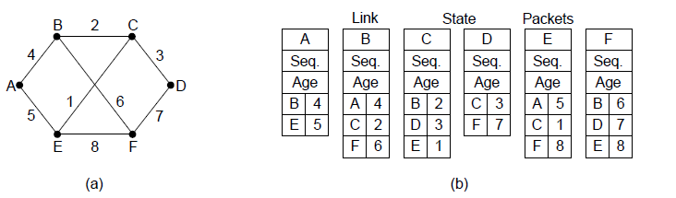
Building Link State Packets
(a) A network. (b) The link state packets for this network.
Computer Networks, Fifth Edition by Andrew Tanenbaum and David Wetherall, © Pearson Education-Prentice Hall, 2011

Slide 19
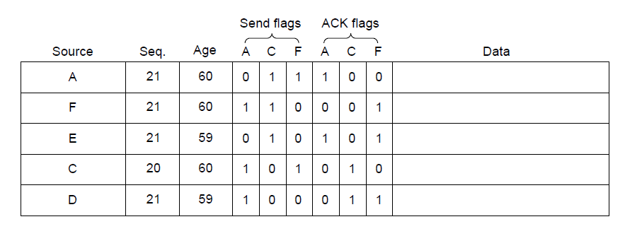
Distributing the Link State Packets
The packet buffer for router B in previous slide
Computer Networks, Fifth Edition by Andrew Tanenbaum and David Wetherall, © Pearson Education-Prentice Hall, 2011

Slide 20
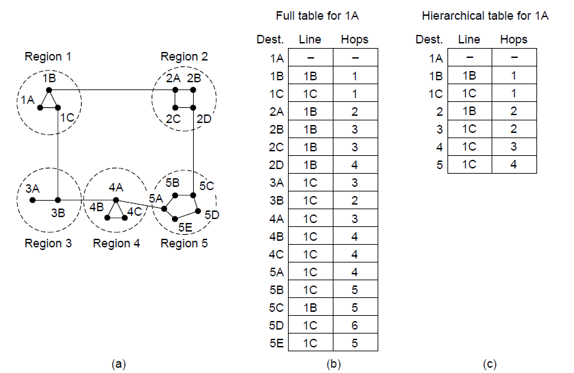
Hierarchical Routing
Hierarchical routing.
Computer Networks, Fifth Edition by Andrew Tanenbaum and David Wetherall, © Pearson Education-Prentice Hall, 2011

Slide 21
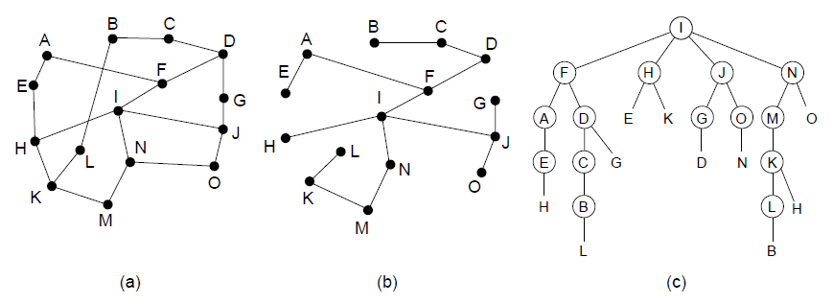
Broadcast Routing
Reverse path forwarding. (a) A network. (b) A sink tree. (c) The tree built by reverse path forwarding.
Computer Networks, Fifth Edition by Andrew Tanenbaum and David Wetherall, © Pearson Education-Prentice Hall, 2011

Slide 22
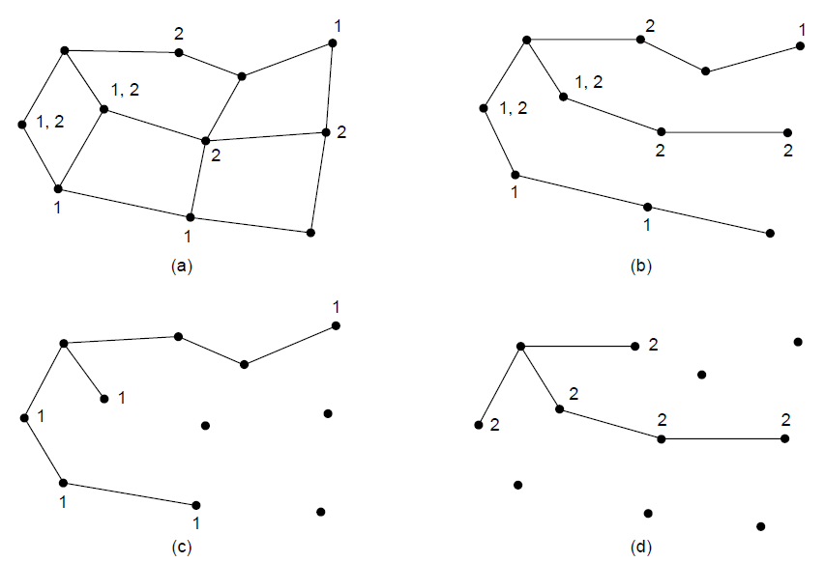
Multicast Routing (1)
(a) A network. (b) A spanning tree for the leftmost router. (c) A
multicast tree for group 1. (d) A multicast tree for group 2.
Computer Networks, Fifth Edition by Andrew Tanenbaum and David Wetherall, © Pearson Education-Prentice Hall, 2011

Slide 23
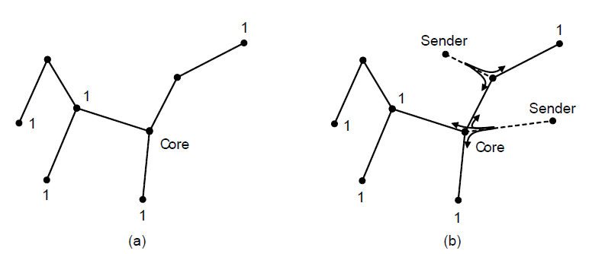
Multicast Routing (2)
Core-based tree for group 1.
Sending to group 1.
Computer Networks, Fifth Edition by Andrew Tanenbaum and David Wetherall, © Pearson Education-Prentice Hall, 2011

Slide 24
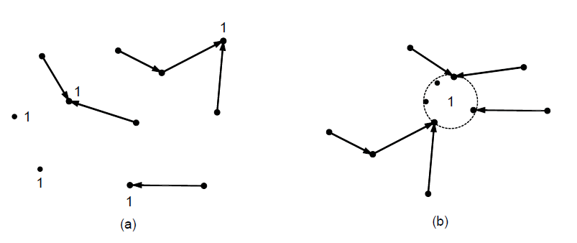
Anycast Routing
Anycast routes to group 1.
Topology seen by the routing protocol.
Computer Networks, Fifth Edition by Andrew Tanenbaum and David Wetherall, © Pearson Education-Prentice Hall, 2011

Slide 25
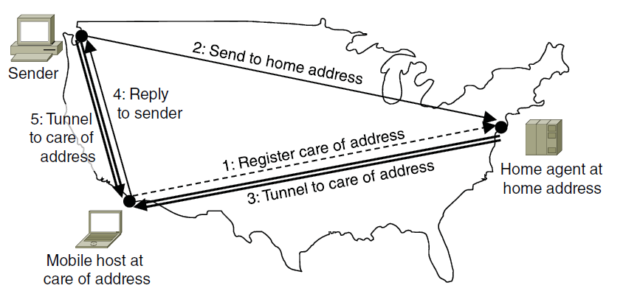
Routing for Mobile Hosts
Packet routing for mobile hosts
Computer Networks, Fifth Edition by Andrew Tanenbaum and David Wetherall, © Pearson Education-Prentice Hall, 2011

Slide 26
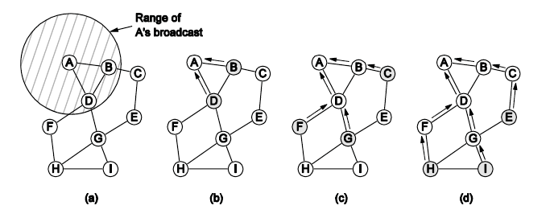
Routing in Ad Hoc Networks
The shaded nodes are new recipients. The dashed lines show possible reverse routes. The solid lines show the discovered route.
Range of A’s broadcast.
After B and D receive it.
After C, F, and G receive it.
After E, H, and I receive it.
Computer Networks, Fifth Edition by Andrew Tanenbaum and David Wetherall, © Pearson Education-Prentice Hall, 2011

